Slide 1



PIMPRI CHINCHWAD EDUCATION TRUST's
PIMPRI CHINCHWAD COLLEGE OF ENGINEERING
PYTHON WORKSHOP
By: Siddhant Pawar

Slide 2

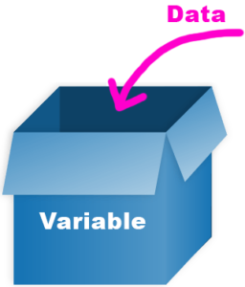
? What’s a variable?
A variable is a special type of amount or quantity with an unknown value.
Example: X + 10 = 20 where X is a variable.
It’s a placeholder in the place of unknown value.
But in Python or any other programming language variable is like container in which we store value(s).

Slide 3
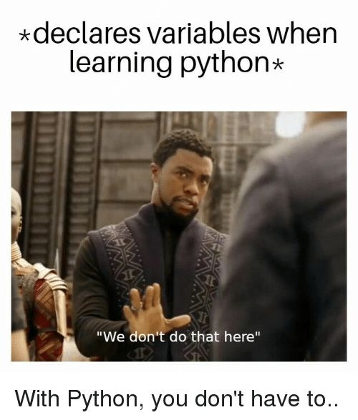

Declaring Variables
In other languages, we declare
Variables by using name of datatype
And than variable name.
But in Python only variable name
And value(this is also optional)

Slide 4
Types of Datatypes
Integers
Floating-Point Numbers
Complex Numbers
Strings
Boolean
List
Tuple
Dictionary

Slide 5
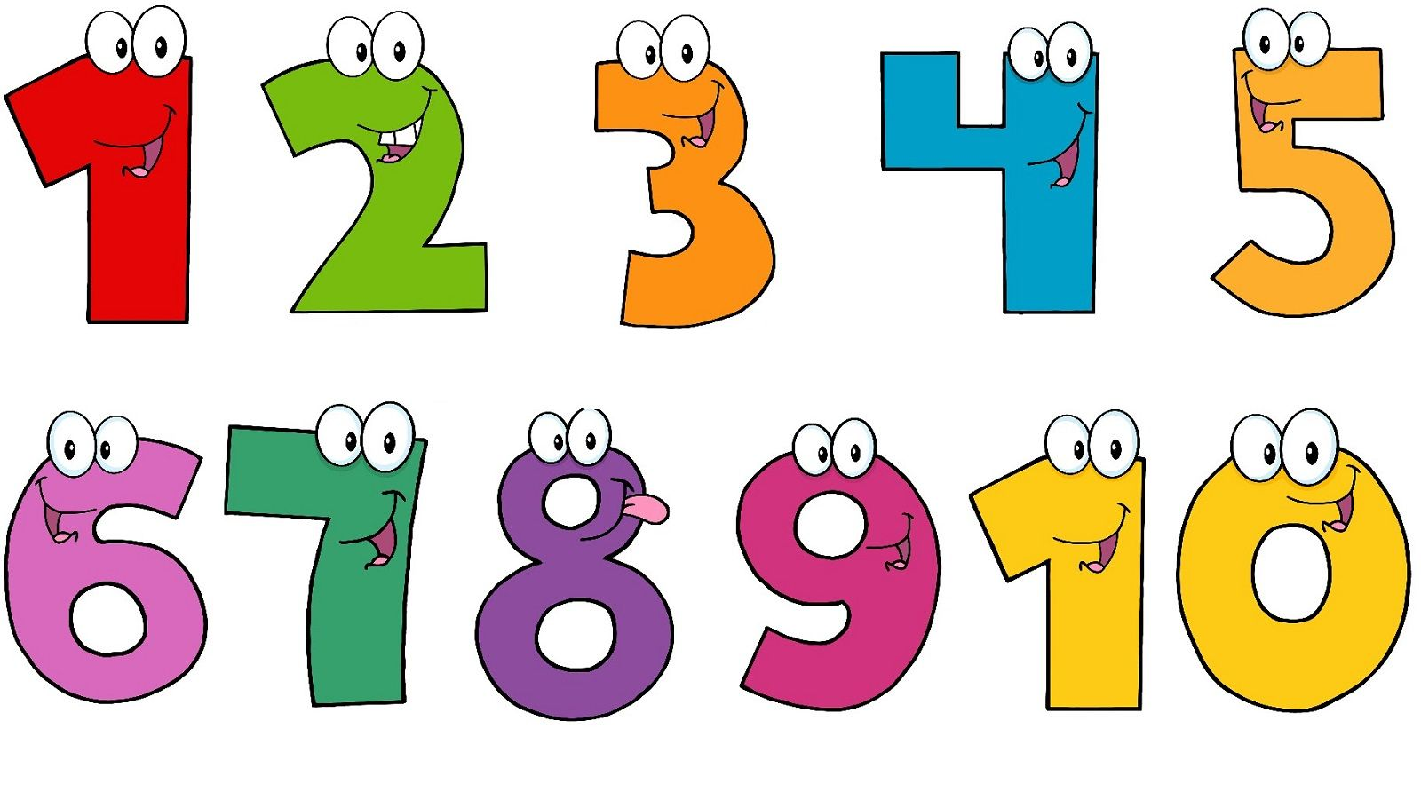
Numeric Datatypes
Datatype
Example
Integer
Float
Complex
x = 10
x = 10.0
x = 10 +10j

Slide 6
Strings
Declaring ways
Example
Single line
Multiline
x = ‘Hello’
x = '''
Hello world
this is python
'''

Slide 7
Strings are arrays
a = ‘hello world’
print(a[1])
b = ‘Python is very easy to learn’
print(b[:6])
c = 'abcdefghijklmnopqrstuvwxyz’
print(c[::3])
print(c[::-1])

Slide 8

Lists
Lists are used to store multiple items in a single variable.
List items are ordered, changeable, and allow duplicate values.
List items are indexed, the first item has index 0, the second item has index 1 etc.
List is Heterogeneous type of variable.

Slide 9
Append in list
list1 = [1,2,3,'hi’,9]
print('list1',list1)
list1.append(10)
print('list1',list1)
Appending means to add an elements at the end of list
list2 = [1,2,4,5]
print('list2',list2)
list2.append('6')
print('list2',list2)

Slide 10
Append in list
Appending using loops
list3 = []
print('list3',list3)
for i in range(5):
list3.append(i)
print('list3',list3)
Extend to add many elements at one time
list4 = [1,2,3,4,5,6]
print('list4',list4)
list4.extend([7,8,9])
print('list4',list4)

Slide 11
Using insert to add elements
list5 = [1,2,3,4,5,6]
print(list5)
list5.insert(1,10)
print(list5)

Slide 12
remove vs pop
list6 = [1,2,3,'hi',9]
print('list6',list6)
list6.remove('hi')
print('list6',list6)
list6.pop()
print('list6',list6)
list6.pop(1)
print('list6',list6)

Slide 13
Clear means to delete all the elements present in the list and length of list
list7 = [1,5,2,5,7,3,2,1]
print('list7',list7)
list7.clear()
print('list7',list7)
Length of list
list8 = [1,5,2,5,7,3,2,1]
print(len(list8))

Slide 14
Sorting ascending and descending
list9 = [1,5,2,5,7,3,2,1]
print('list9',list9)
list9.sort()
print('list9',list9)
list9.sort(reverse=True)
print('list9',list9)

Slide 15
Tuples
Tuples are used to store multiple items in a single variable.
A tuple is a collection which is ordered and unchangeable.

Slide 16
Tuple declaration
tup1 = (1,'hi',4)
print('Datatype of tup1 :',type(tup1))
tup2 = (1,2,3,4)
tup3 = (5,6,7,8)
print('tup2',tup2)
print('tup3',tup3)

Slide 17
Adding Tuples and Swapping tuples
Adding tuples
tup2 = (1,2,3,4)
tup3 = (5,6,7,8)
tup4 = tup2 + tup3
print('tup4',tup4)
Swapping tuples
tup2, tup3 = tup3, tup2
print('tup2',tup2)
print('tup3',tup3)

Slide 18
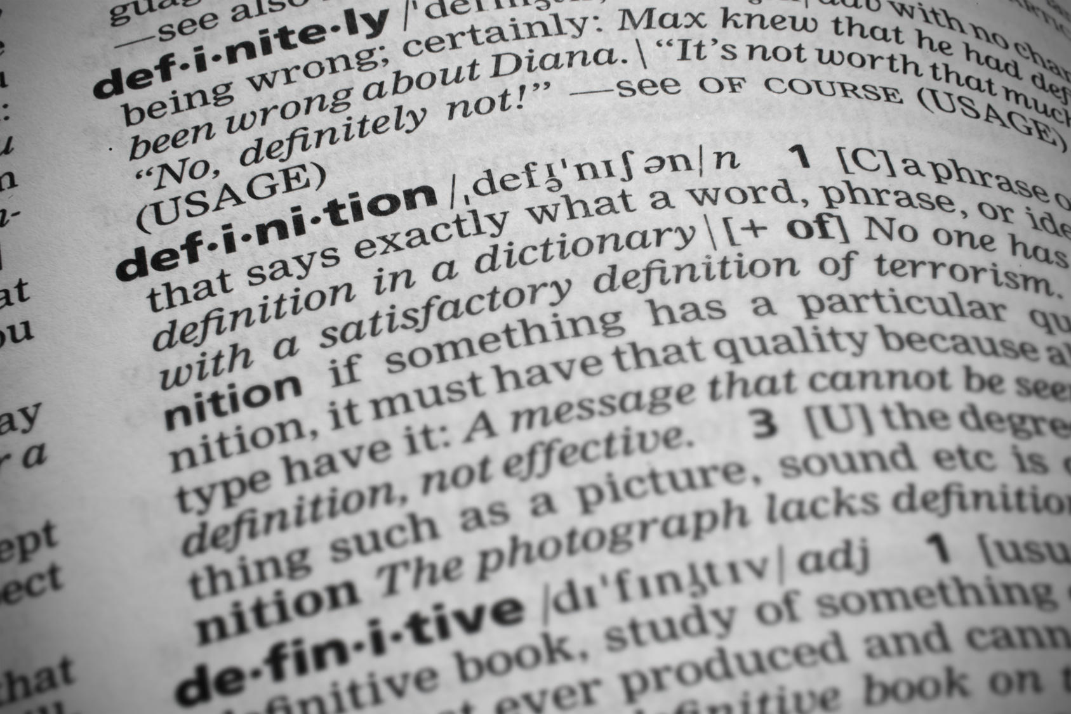
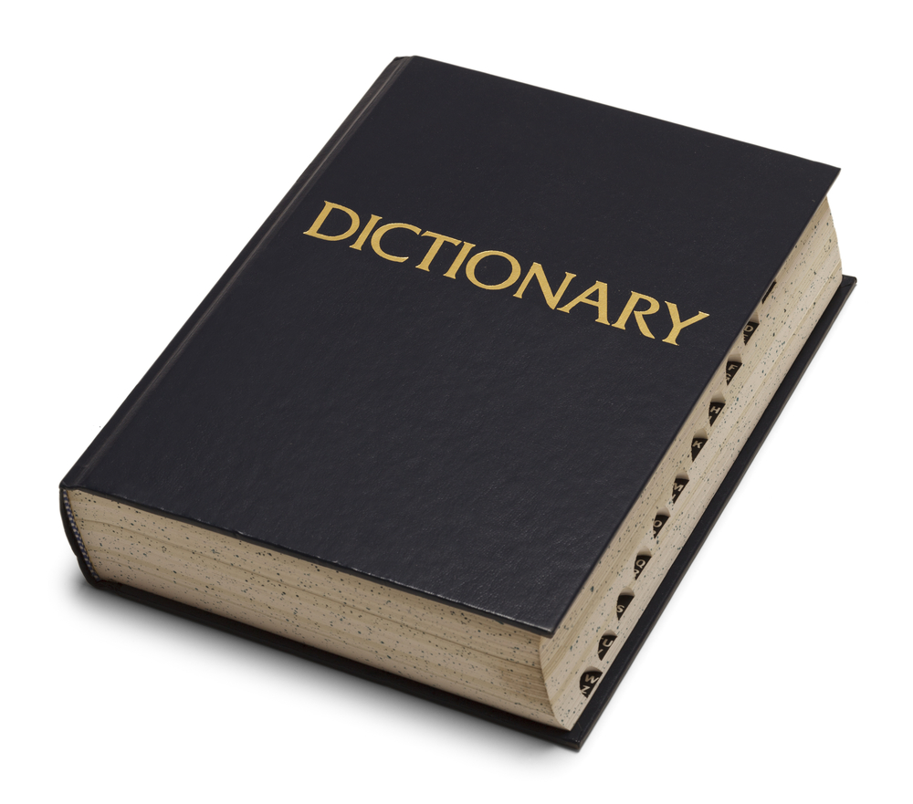
Dictionary
A dictionary is a collection of key value pairs.
A dictionary is a collection which is unordered, changeable and indexed.

Slide 19
Seeing a Dictionary and Creating Dictionary
Seeing a dictionary
dict1 = {}
print('dict1 :',dict1)
print('type(dict1) :',type(dict1))
Creating Dictionary
dict2 = {1:'A',2:'B',3:'c',4:'d'}
print('dict2 :',dict2)

Slide 20
Different ways of accessing items of Dictionary
dict3 = dict([(1,'hi'),(2,'i am'),(3,'fine')])
print('dict3 :',dict3)
print('keys :',dict3.keys())
print('values :',dict3.values())
print('dict3[1] :',dict3[1])

Slide 21
Nested Dictionary and its accessing
dict4 = {1:'a',2:'b',3:'c',4:'d',5:['e','f'],6:{'A':'hi','B':'I','C':'am'}}
print('dict4 :',dict4)
print('dict4 :',dict4[5])
print('dict4[5][1] :',dict4[5][1])
print('dict4[6] :',dict4[6])
print('dict4[6]["B"] :',dict4[6]["B"])

Slide 22
Adding a value in Dictionary
dict5 = {1:'a',2:'b',3:'c',4:'d'}
print('dict5 :',dict5)
dict5[5] = 'e'
print('dict5 :',dict5)

Slide 23
pop() and clear()
Removing a key value pair using pop()
dict5.pop(5)
print('dict5 :',dict5)
Clearing the Dictionary using clear()
dict5.clear()
print('dict5 :',dict5)

Slide 24
update() and del
Extending a Dictionary using update() and second Dictionary
dict6 = {1:'a',2:'b',3:'c',4:'d'}
dict7 = {5:'e',6:'f'}
print(dict6)
print(dict7)
dict6.update(dict7)
print(dict6)
Deleting a Dictionary using del
del dict7
print(dict7)

Slide 25


